Slide 1


Tamenny
A Real-time AI-powered Healthcare Diagnostic Application for Patients
Graduation project
2024-2025
Tamenny
Start Page
>

Slide 2

Team Members
Muaz Osama Ahmed
2101130
Mohamed Tharwat
2101135
Youssef Ashraf
2101727
Kareem Yasser
2100834
Youssef Subra
2101713
Abdelrahman Youssef
2100287
Under the Supervision of
Dr. Mohamed Zidan
Lecturer in Computer and Information Technology
Egyptian E-Learning University
T.A. Mohamed Mustafa
Teacher Assistant in Computer and Information Technology
Egyptian E-Learning University
1

Slide 3
Agenda
1
2
3
4
5
Introduction
Problem Statement
Problem Solution
Related Work
Implementation
Using technology to transform healthcare efficiency.
Delays in diagnosis harm health outcomes.
AI offers quick preliminary diagnosis for users.
Learning from similar systems for better design.
Built using agile methods for flexibility and efficiency.
6
7
8
9
10
Result
Technologies &Tools
Conclusion
Time Plan
Future Work
AI diagnoses, personalized insights, and community support for better healthcare.
AI and modern tools ensure precision and speed.
Revolutionizing healthcare with AI-driven solutions.
Structured timeline for accurate and timely delivery.
add new features for the application
11
12
13
Refrences
Thank You
Research papers on AI in healthcare, Trusted medical sources for disease insights.
Gratitude for support and attention.
2

Slide 4

Tamenny
Introduction

Slide 5
Tamenny uses advanced AI techniques to analyze medical images and tests, giving users an accurate initial evaluation of their condition. It also features an intelligent chatbot that interacts with users, assessing symptoms through a simple conversation and offering possible health insights.
Tamenny integrates a community feature where users can connect with specialized doctors for guidance and medical advice, fostering a supportive environment for better healthcare decisions.
The app addresses key challenges such as limited access to specialists in remote areas, the high cost of medical tests, and the importance of early detection for diseases like cancer and heart conditions.
4

Slide 6
Tamenny
Problem
Statement

Slide 7
Delayed Diagnosis: Many patients experience delays in diagnosis due to difficulty accessing specialized doctors or the absence of regular check-ups.
Absence of Integrated Technological Solutions: There are no comprehensive applications that combine AI-based diagnosis with a medical community to support patients.
Difficulty Communicating with Doctors: Patients may struggle to obtain quick medical consultations, especially in remote areas.
Lack of Health Awareness: Many individuals are unaware of the early symptoms of serious diseases like cancer and heart conditions, leading to delays in seeking medical help.
High Cost of Diagnosis: Specialized medical tests such as CT scans and MRIs can be expensive and inaccessible to many.
Lack of Personalized Medical Guidance: Users struggle to find the right doctors, tests, or preventive steps for their specific condition
6

Slide 8
Tamenny
Problem Solution

Slide 9
A mobile application: integrates Computer Vision (CV) , Artificial Intelligence (AI) and Natural Language processing (NLP) to provide automated disease diagnosis and patient interaction.
Interactive Medical Community: Allows users to share experiences, seek advice, and connect with doctors for additional guidance.
Affordable Diagnosis: Offers low-cost, AI-powered initial diagnosis, reducing financial barriers.
Accessible Health Education: Delivers helpful information about diseases, symptoms, and prevention methods.
Personalized Medical Recommendations: AI system that analyzes symptoms and history to recommend suitable doctors, tests, and preventive care — for faster and personalized treatment.
8

Slide 10
Tamenny
Related
Work

Slide 11
Title | Year | Author | Results
Heart Disease Diagnosis Using Deep Learning | 2023 | Cheerla Ganesh, Lordson Gnana Durai A,Baavana Bandarupalli,S. Pavithra, R. Prabanjan | High Prediction Accuracy: Achieves 90% precision, outperforming existing methods by 4.4%. Comprehensive Analysis: Considers key health factors such as age, cholesterol, and heart rate. Healthcare Impact: Provides advanced heart disease prediction to improve patient outcomes.
Enhancing Lung Cancer Classification: Leveraging Existing Convolutional Neural Networks within a 1D Framework | 2024 | Nurul Najiha Jafery, Siti Noraini Sulaiman, Muhammad Khusairi Osman, Noor Khairiah A. Karim, Zainal Hisham Che Soh | Early Detection: Enhances survival rates through a focus on early lung cancer detection High Accuracy: Achieves up to 94.67% accuracy using VGG-16.
10

Slide 12
Title | Year | Author | Results
Osteoporosis Prediction Using VGG16 and ResNet50 | 2024 | Ashadu Jaman Shawon, Ibrahim Ibne Mostafa Gazi, Humaira Rashid Hiya, and Ajoy Roy. | The ResNet50 model achieved an accuracy of 98% in classifying images as indicative of osteoporosis or normal bone density, while the VGG16 model reached 78% accuracy. By combining these models and employing advanced image segmentation techniques, the system detected early signs of osteoporosis with an overall accuracy of 96%.
Brain Tumor Detection Using Convolutional Neural Network | 2024 | Vijay Mane, Atharva Balasaheb Chivate, Prajyot Ambekar, Atul Rajaram Chavan, and Ameya Pangavhane | presented a deep learning approach utilizing Convolutional Neural Networks (CNNs) for the detection of brain tumors in MRI scans. The proposed model achieved a loss of 0.1314 and an accuracy of 94.20% on a test dataset, demonstrating high levels of precision, sensitivity, and reliability in identifying brain malignancies. The study highlights the efficiency of CNN-based models in analyzing medical imaging and suggests future extensions including tumor segmentation, multi-class classification, and integration of multi-modal data to support advanced clinical decision-making.
11

Slide 13
Limitations
1- Limited precision in existing heart disease diagnosis models.
2- Low survival rates due to delayed lung cancer detection.
3- Difficulty in early osteoporosis detection and classification.
12

Slide 14

outcome:
Tamenny bridges gaps in healthcare, making accurate diagnosis and support.
13

Slide 15
Tamenny
Implementation

Slide 16
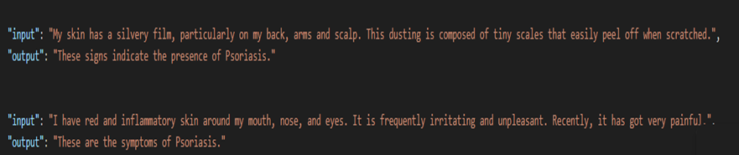
ChatBot Model Implementation:
Fig-1:
Psoriasis Symptoms Tag in Chatbot Training Data
Structure
"This dataset, with 3835 input/output pairs, is designed for two main purposes: diagnosing diseases (e.g., Psoriasis, Typhoid) based on specific keywords and providing general chatbot responses, including health advice.
·The dataset follows an instruction-based format (Input ➜ Output), using natural symptom language similar to real user expressions. It includes both clean and noisy examples to improve robustness, making it ideal for instruction-style fine-tuning
Use Case: Chatbot in Healthcare
1- Symptom Recognition 2- Disease Identification 3- Medical Guidance
15

Slide 17
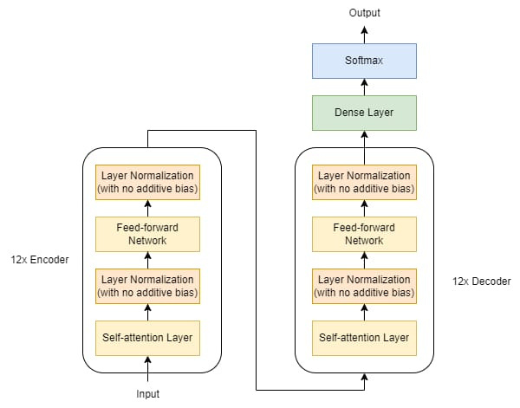
Chatbot implementation :
FLAN-T5-Base Model Structure
1. Introduction
FLAN-T5 is a fine-tuned version of Google's T5 (Text-To-Text Transfer Transformer), trained with instruction-based prompts. The Base version offers a good balance between performance and speed.
2-Architecture Overview
Model Type: Encoder-Decoder Transformer (12 Encoder + 12 Decoder) layers.
Attention: Multi-head (8 heads) with relative positional encoding.
FFN: 2-layer MLP (Hidden: 768, Intermediate: 2048).
Parameter Count: ~250M.
Fine-tuning: Instruction tuning for multi-task performance.
Fig-2
Flan-T5 structure
16

Slide 18
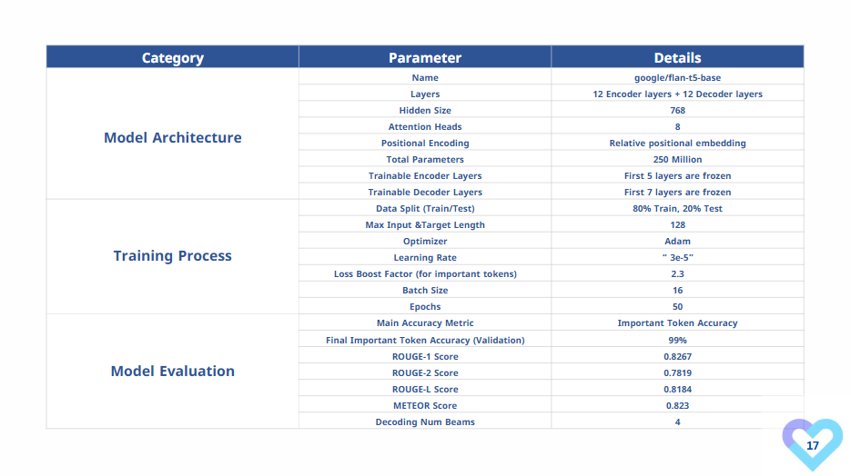

Slide 19
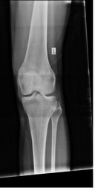
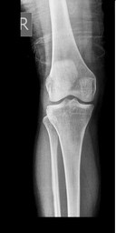
Knee Osteoarthritis Resnet model implementation:
Dataset:
This dataset is collected from
https://data.mendeley.com/datasets/fxjm8fb6mw/2
commonly used by researchers, academics, and scientists to publish and access datasets that support scientific research.
for 2classes Normal and Osteoporosis.
you can use it to make a model to predict the Osteoporosis
Dataset Loading:
The load_dataset_as_dataframe function creates a DataFrame with paths to images and their labels, based on a directory structure.
Training and testing datasets are stored in separate subdirectories (train and test).
Fig-3-1
Normal knee apperance
Fig-3-2:
Osteoporosis knee apperance
18

Slide 20
Category | Parameter | Details
Data prepartion | Augmentation | Training data undergoes augmentation: Resize to 224×224224 \times 224224×224. Random horizontal flips, random rotations, and brightness/contrast adjustments. Normalization using ImageNet mean and standard deviation. Testing data is resized and normalized similarly, but no augmentations are applied.
Model Architecture | Model Type | ResNet50
Model Architecture | Residual Block | The core building blocks of ResNet50. These blocks contain multiple convolutional layers with batch normalization and ReLU activation, and a "skip connection" to detect featyres
Model Architecture | Average Pooling | Before the final fully connected layer, ResNet50 typically uses average pooling to reduce the spatial dimensions of the feature maps.
Model Architecture | Fully Connected Layer (Custom) | Linear layer followed by a Softmax activation function to produce probabilities for each class (Normal, Osteoarthritis).
Training Process | Optimizer | Adam
Training Process | Batch Size: 32 ,Epochs: 100 | Number of images processed in each training iteration. Number of passes through the entire training dataset.
Training Process | Data Augmentation | Random Horizontal Flips (p=0.5)<br>* Random Rotations (degrees=10)<br>* Color Jitter (contrast=0.2, brightness=0.2)
Model Evaluation | Test Accuracy | 96.5%
Model Evaluation | Metrics | Confusion Matrix, Classification Report
19

Slide 21
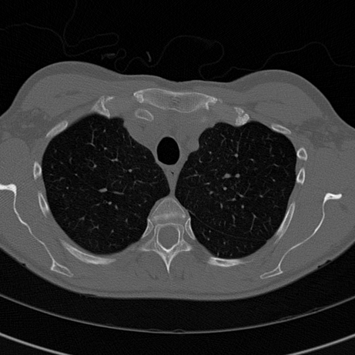
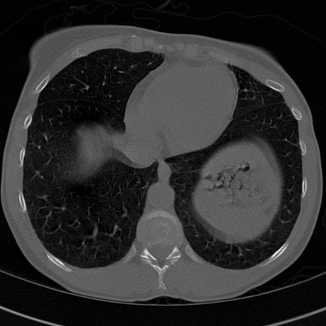
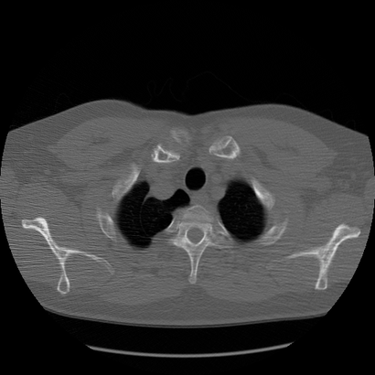
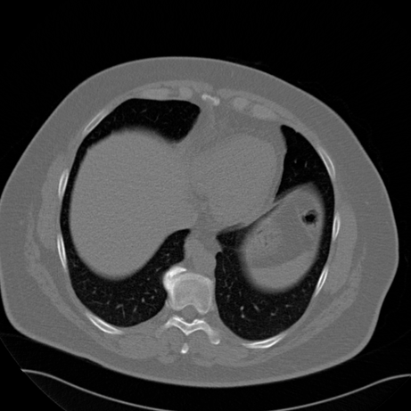
Heart segmentation Unet model implementation:
Dataset Contents :
CT Scan Images: volumetric data stored in formats like DICOM
Segmentation Masks: Binary or multi-class masks labeling different anatomical structures
Metadata: Includes anonymized patient demographics and image acquisition parameters
Fig4-1
Heart dataset sample
Fig4-2
Heart dataset sample
Fig4-3
Heart dataset sample
Fig4-4
Heart dataset sample
20

Slide 22
Heart segmentation Unet model implementation:
Category | Parameter | Description
Data Preparation | Image Size | 256x256 pixels (resized images)
Data Preparation | Augmentation Techniques | Horizontal Flip, Vertical Flip, Rotation
Data Preparation | Train-Validation Split | 80% training, 20% validation
Model Architecture | Model Type | U-Net
Model Architecture | Encoder Layers | Convolution + Batch Normalization + MaxPooling
Model Architecture | Decoder Layers | UpSampling + Convolution + Concatenate
Model Architecture | Dropout Rate | 0.2
Model Architecture | Output Layer Activation | Sigmoid
Training Process | Loss Function | Dice Loss
Training Process | Metrics | Accuracy
Training Process | Optimizer | Adam with Learning Rate (0.01)
Training Process | Epochs | 10
Training Process | Batch Size | 16
Training Process | Callbacks | Early Stopping, Reduce Learning Rate
Model Evaluation | Test Accuracy | 96%
21

Slide 23
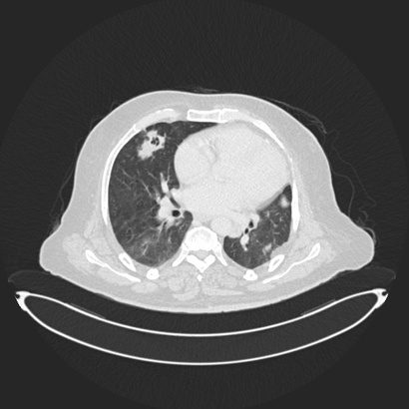
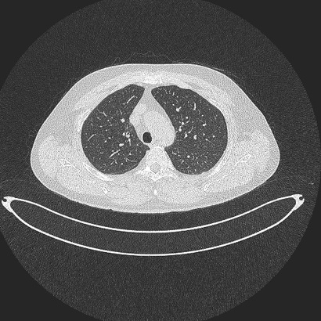
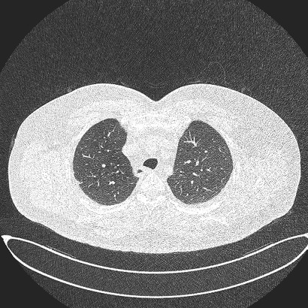
Lung cancer CNN model implementation:
1.Dataset Overview:
Total Images: 1,190 CT scan slices
Total Cases: 110 patients
Classification:
Malignant Cases: 40
Benign Cases: 15
Normal Cases: 55
2.Imaging Specifications
Modality: Computed Tomography (CT)
Format: DICOM
Scanner: Siemens SOMATOM
3.Data Preparation:
Preprocessed CT scans (Resized, Normalized, Encoded) Split data into Training (75%) and Testing (25%)
4.Libraries TensorFlow/Keras, NumPy, PIL, Matplotlib/Seaborn, Scikit-learn
Fig5-1 : Normal lung appearance
Fig5-2 : Malignant lung appearance
Fig5-3 : Begnin lung appearance
22

Slide 24
Category | Parameter | Details
Model Architecture | CNN | 11 layers
Model Architecture | Conv2D (64 filters) | Detects basic features (edges)
Model Architecture | BatchNorm + ReLU | Improves convergence
Model Architecture | MaxPooling2D | Reduces spatial dimensions
Model Architecture | Residual Block | Two Conv2D (64 filters) + Add Layer
Model Architecture | MaxPooling2D | Further reduces dimensions
Model Architecture | Conv2D (64 filters) | Extracts deeper features
Model Architecture | BatchNorm + ReLU | Enhances performance
Model Architecture | Dropout (0.5) | Prevents overfitting
Model Architecture | Flatten | Converts to 1D array
Model Architecture | Dense (256 units) | Processes features for classification
Model Architecture | Dense (Softmax) | Outputs probabilities (Normal, Benign, Malignant)
Training Process | Optimizer | Adam (LR: 0.0001)
Training Process | Loss Function | Categorical Crossentropy
Training Process | Batch Size: , Epochs: | 16, 80
Training Process | Callbacks: | Early Stopping, Model Checkpointing
Model Evaluation | Test Accuracy: | 99%
Model Evaluation | Metrics: | Confusion Matrix, Classification Report
23

Slide 25
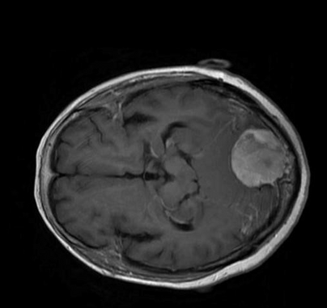
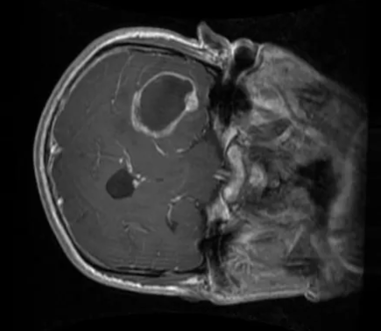
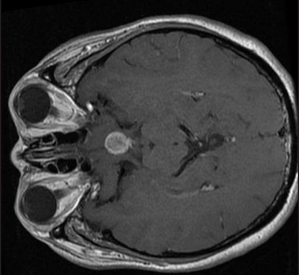
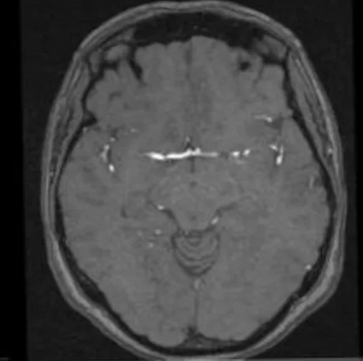
Brain Cancer CNN model implementation:
1.Dataset Overview:
This dataset contains MRI brain scan images that are categorized into four classes to help build a classification model for detecting brain tumors.
2.Classes in the Dataset
brain_menin – Meningioma tumor
brain_glioma – Glioma tumor
brain_pituitary – Pituitary tumor
no_tumor – Healthy brain with no tumor
3.Data Preparation:
All images are resized to 128x128 pixels using OpenCV.
Images are loaded and converted into numerical arrays suitable for training.
Labels are encoded as numerical categories (0, 1, 2, 3).
Fig6-1
brain_menin
Fig6-2
brain_glioma
Fig6-3
brain_pituitary
Fig6-4
brain_no tumor
24

Slide 26
Category | Parameter | Details
Model Architecture | CNN | 11 layers
Model Architecture | Conv2D (64 filters) | Detects basic features (edges)
Model Architecture | BatchNorm + ReLU | Improves convergence
Model Architecture | MaxPooling2D | Reduces spatial dimensions
Model Architecture | Residual Block | Two Conv2D (64 filters) + Add Layer
Model Architecture | MaxPooling2D | Further reduces dimensions
Model Architecture | Conv2D (64 filters) | Extracts deeper features
Model Architecture | BatchNorm + ReLU | Enhances performance
Model Architecture | Dropout (0.5) | Prevents overfitting
Model Architecture | Flatten | Converts to 1D array
Model Architecture | Dense (256 units) | Processes features for classification
Model Architecture | Dense (Softmax) | Outputs probabilities (meningioma, glioma, pituitary, no tumor)
Training Process | Optimizer | Adam (LR: 0.0001)
Training Process | Loss Function | Categorical Crossentropy
Training Process | Batch Size: , Epochs: | 16, 80
Training Process | Callbacks: | Early Stopping, Model Checkpointing
Model Evaluation | Test Accuracy: | 98%
Model Evaluation | Metrics: | Confusion Matrix, Classification Report
25

Slide 27
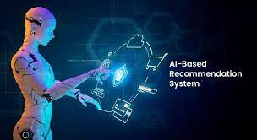
Recommendation System
1-Recommendation System in "Tamenny" App
Objective:
To deliver personalized medical content and news to each user based on their health interests and activity, increasing engagement and offering more relevant support .
How Does the System Work?
🔹 Phase 1: Post Classification
When a user creates a new post, it is processed through a pre-trained XLM-R model.
The model classifies the post into one of five medical categories:
🫀 Heart 🧠 Brain 🫁 Lung 🦵 Knee ⚪ Neutral (General)
26

Slide 28
Recommendation System
Phase 2: User Interest Profiling
The system calculates interest ratios for each medical category based on:
Uploaded medical scans.
Likes and comments on posts.
Posts created by the user.
Phase 3: Intelligent Recommendation Model
A multi-output neural network regressor takes as input:
The user's interest ratios.
The number of available (yet unseen) posts in each category.
It outputs:
The number of posts to show per category.
27

Slide 29
Recommendation System
Phase 4: Dynamic Feed Population
As the user scrolls:
Interest ratios and content availability are recalculated.
The model runs again to update the feed.
If a category has no posts left, the system fills the gap using other categories proportionally based on interest.
Edge Case Handling
📦 Cold Start (New User):
The app displays 20 posts per category by default.
❌ Category Exhausted:
Posts are redistributed from other categories according to interest.
💡 Interest in One Category Only:
The system still provides variety but emphasizes the user's top category.
28

Slide 30
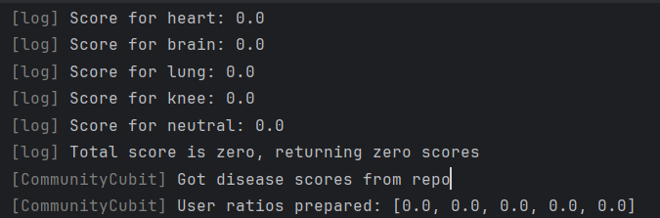
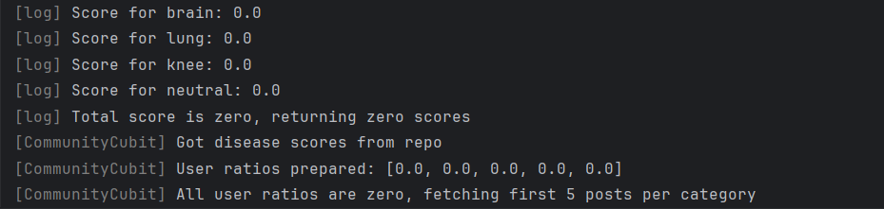
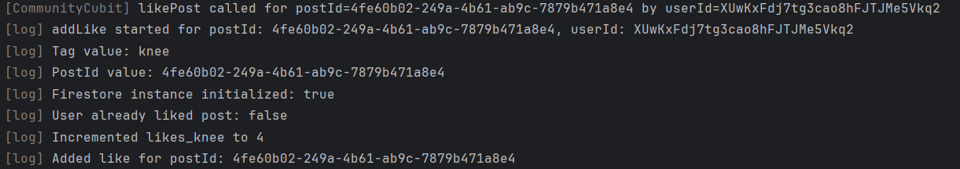
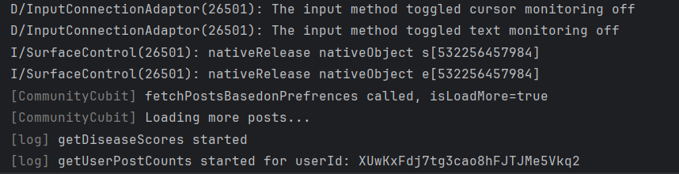
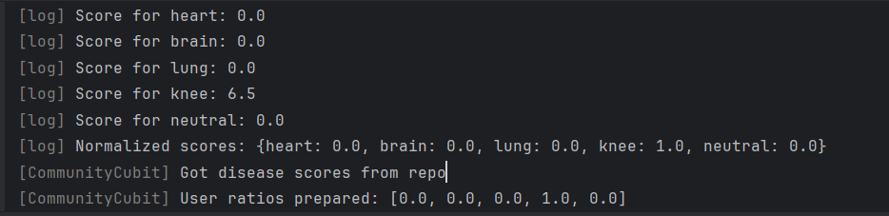
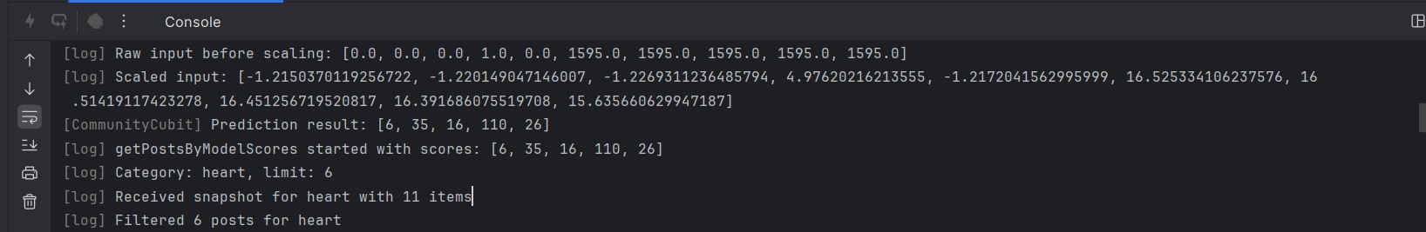
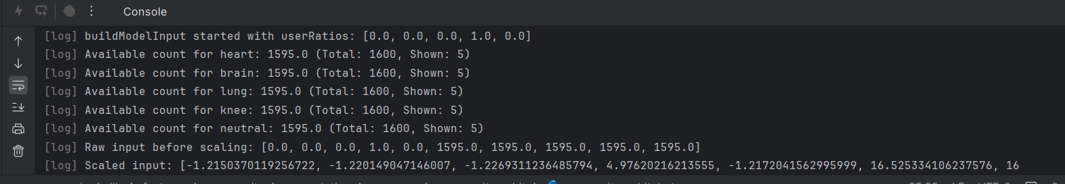
Recommendation System cycle example :
Fig-7
Recommendation Cycle
29

Slide 31
Recommendation System
Additional Features
Medical News Recommendation based on interest profile.
Dynamic Reordering of Category Icons in the app according to user engagement.
Benefits
Personalized experience for every user.
Higher engagement with more relevant content.
Smart and adaptive content delivery based on user behavior.
30

Slide 32
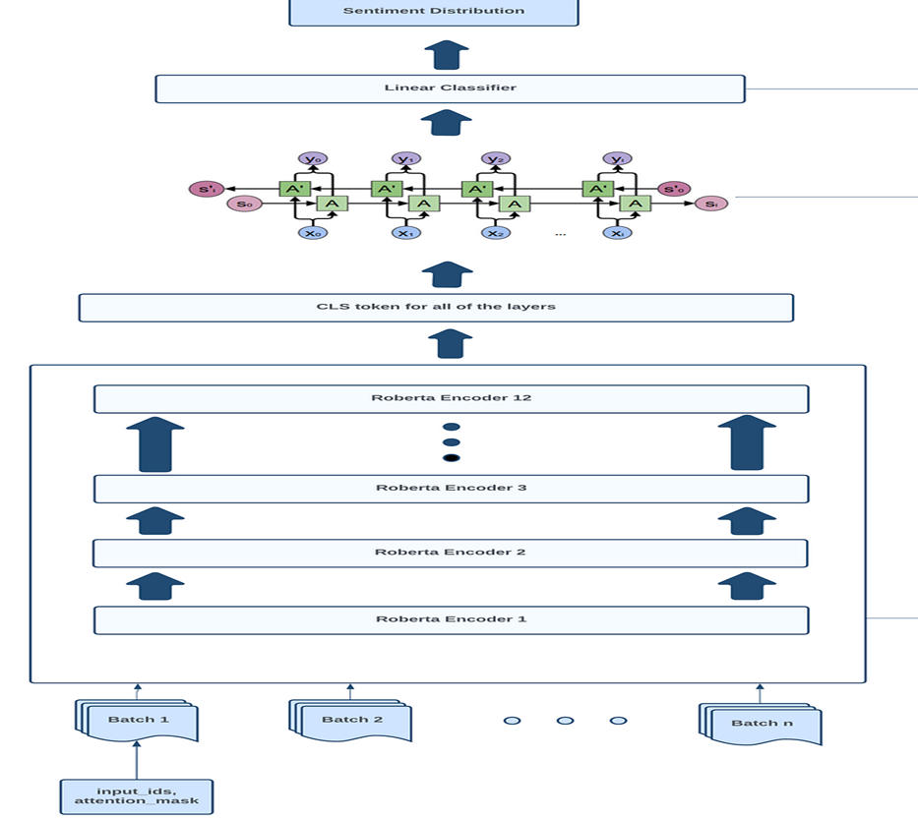
Recommendation System models
1-XLM-RoBERTa post classifier:
Classifies posts into the suitable category making the recommendation can control and manage the system efficintly
XLM-RoBERTa base Architecture:
it is a 12-layer Transformer encoder model, based on RoBERTa, with a hidden size of 768 and 12 attention heads. It uses a SentencePiece subword tokenizer to process multilingual text and is trained solely on masked language modeling (MLM) across a diverse multilingual corpus, omitting Next Sentence Prediction. Its self-attention mechanism captures word dependencies, enabling effective text understanding and classification across languages.
Fig-8 XLM-RoBERTa
31

Slide 33
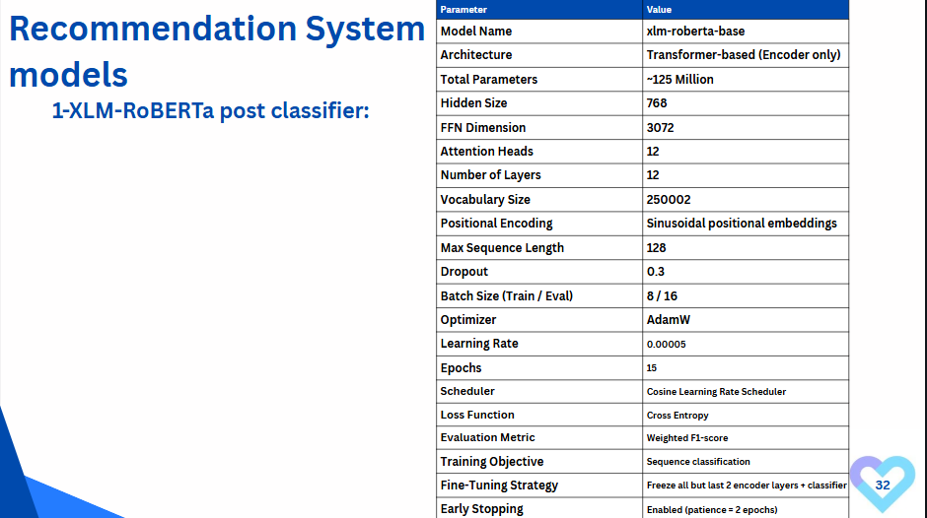

Slide 34
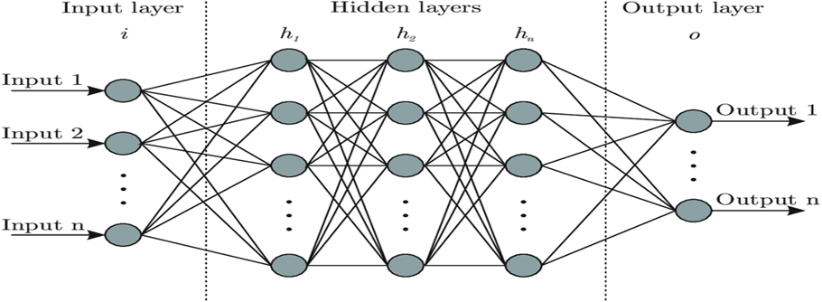
Recommendation System models
2- NN multi regressor:
uses ratios of prefrences and avaliable posts quries to decide how many posts will be shown
2- NN architeture:
The neural network consists of an input layer, multiple hidden layers with dense units and ReLU activation, and an output layer with softmax for multi-class classification. Dropout layers prevent overfitting, batch normalization stabilizes training, and the model is trained using cross-entropy loss with the Adam optimizer.
33
Fig-9 NN multi Regressor

Slide 35
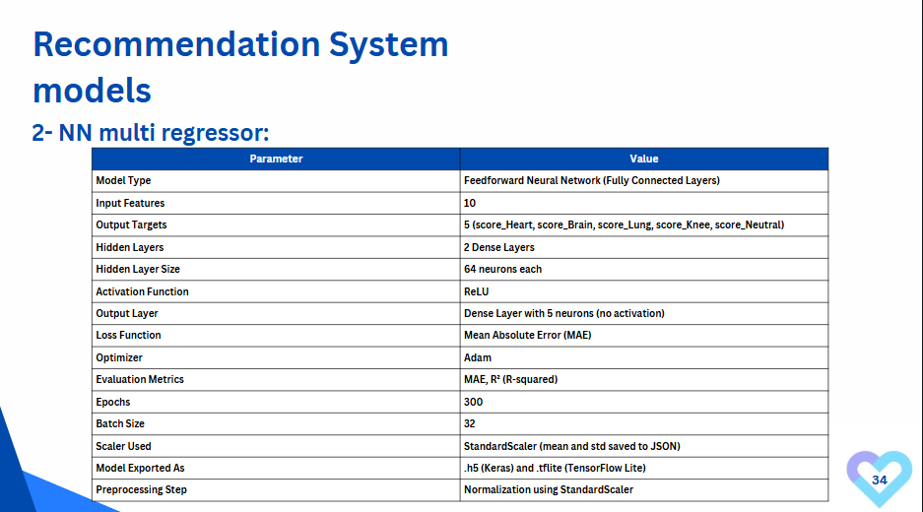

Slide 36
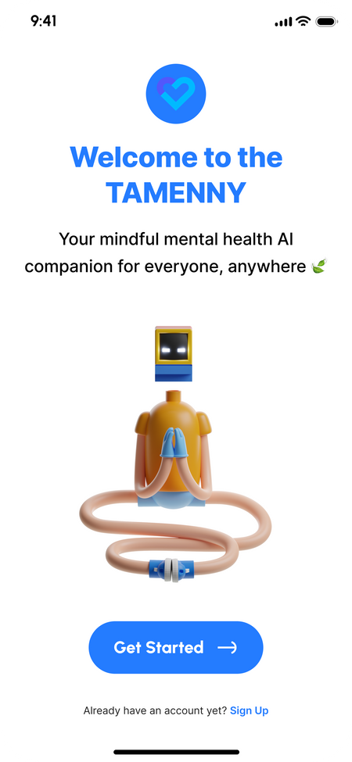
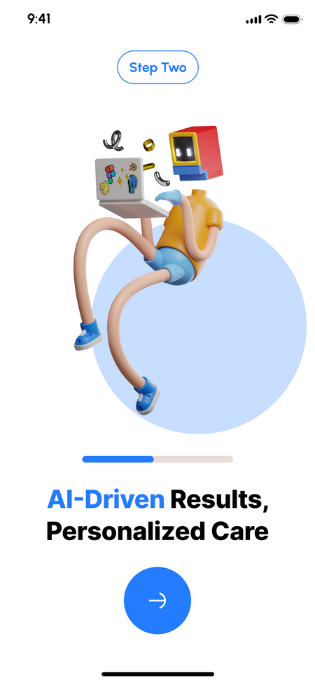


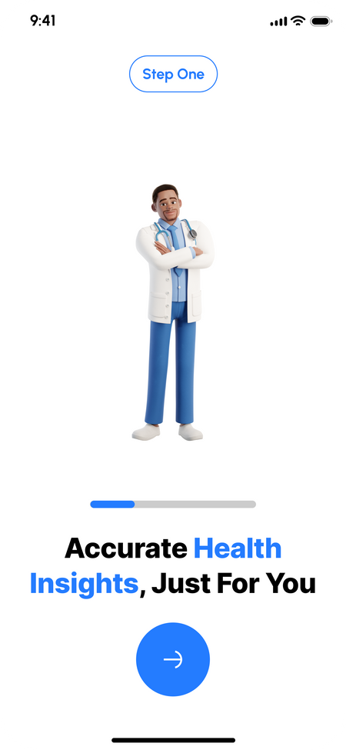
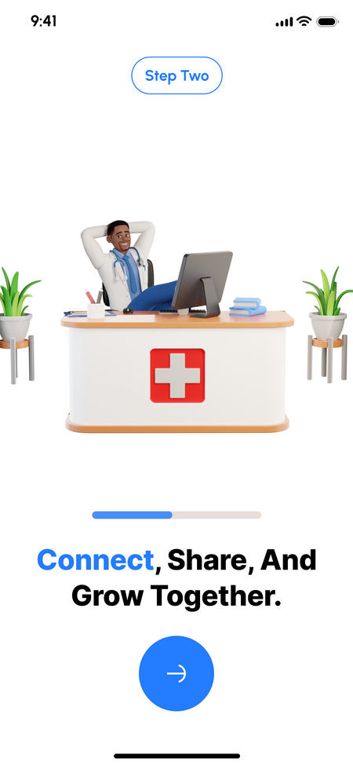
Easy Start with Tameny
Fig-10: OnBoarding Feature
35

Slide 37
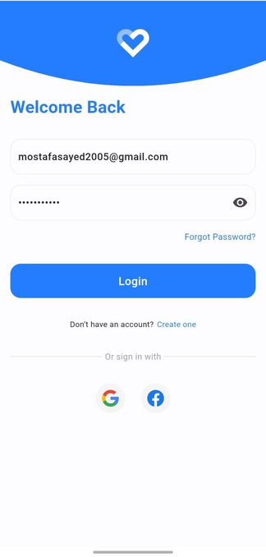
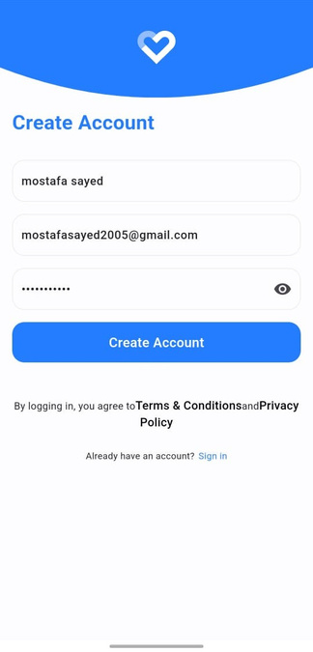
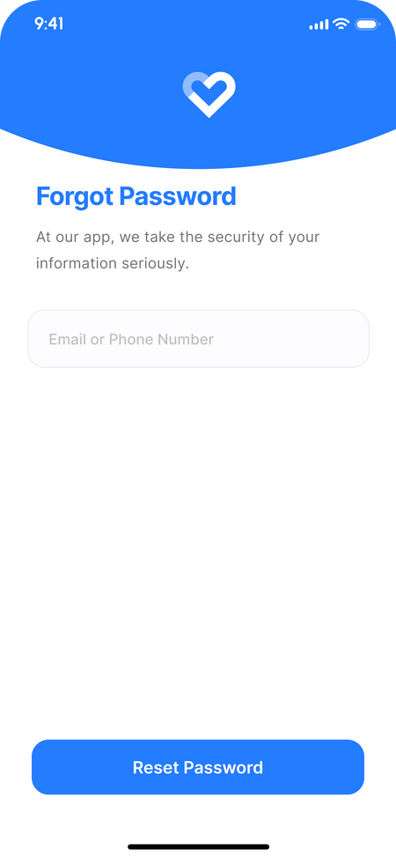
Seamless & Secure Authentication
Log in using email and password.
Quick access with Google or Facebook.
Create a new account with name, email, password.
Reset your password by entering
your registered email or phone number.
Fig-11 : Authentication Feature
36

Slide 38
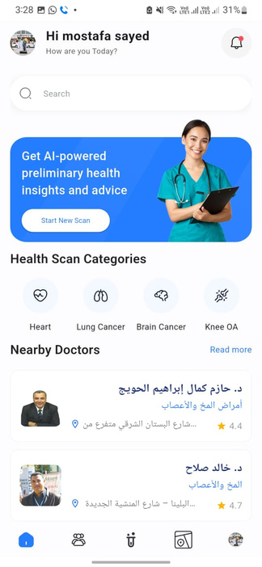
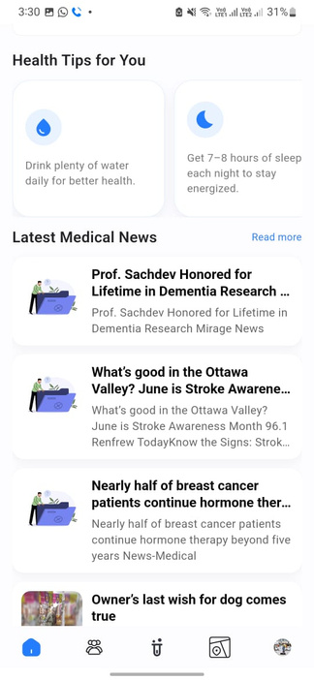
Main dashboard for navigating key user functions
Personalized greeting with the user’s name and a friendly message.
Display of health scan categories for quick navigation to start a scan.
Daily health tips and updates on the latest medical news.
Fig-12 : Home Feature
37

Slide 39
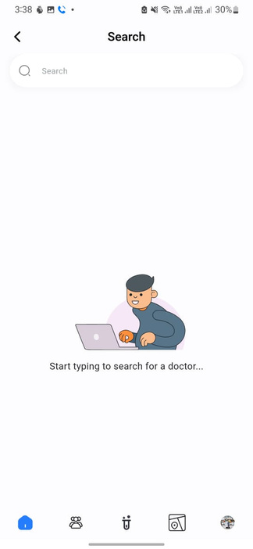
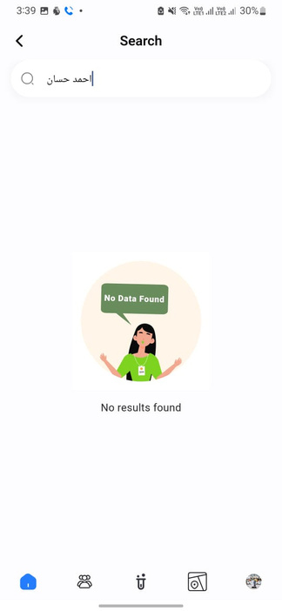

Smart & Swift Search – Find What Matters Instantly
Start searching for a doctor
by typing keywords easily.
Get a clear notification to adjust
your search if no results are found.
Get personalized responses and
quick advice through the search
Fig-13: Search Feature
38

Slide 40
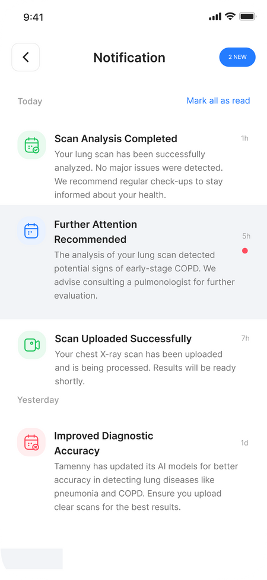
Notifications update users, boost engagement.
1
Alerts for completed scans and follow-up recommendations.
3
Updates on AI accuracy improvements.
2
Success messages like "Scan Uploaded Successfully.
4
Clear design with action buttons for quick responses.
Fig-14: Notification Feature
39

Slide 41
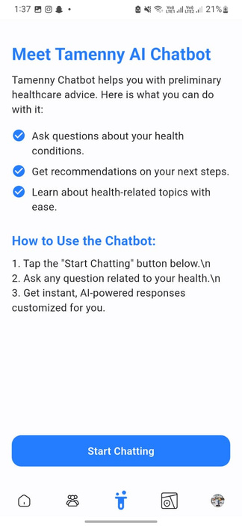
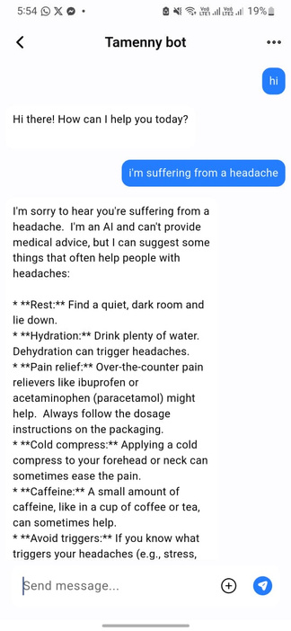
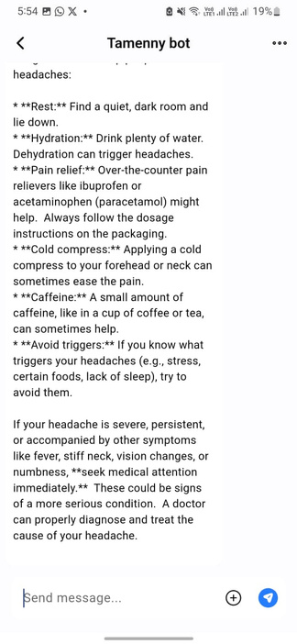
Tamenny AI Chatbot – Your AI Health Assistant
Start chatting with Tamenny AI by
tapping the "Start Chatting" button.
Users type their health questions and
interact with the chatbot in real-time.
Get personalized responses and
quick advice through the chat.
Fig-15: Chatbot Feature
40

Slide 42
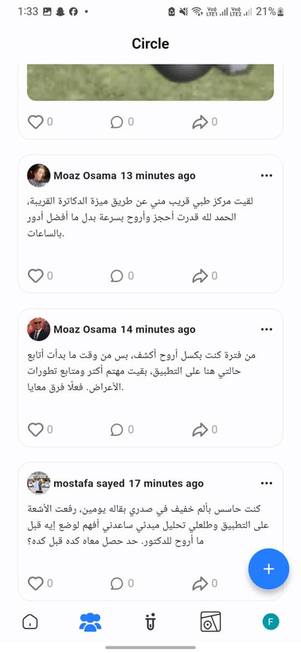
Community & Support Sharing
1
Share health scan results, experiences, and wellness journeys.
3
Connect with trusted health experts for reliable advice.
2
Post insights, ask questions, and engage in discussions.
4
Build confidence, gain support, and stay motivated.
Fig-16.1: Community Feature
41

Slide 43
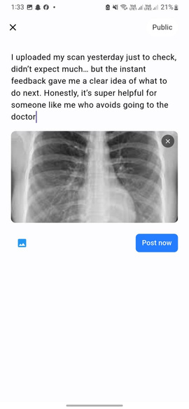
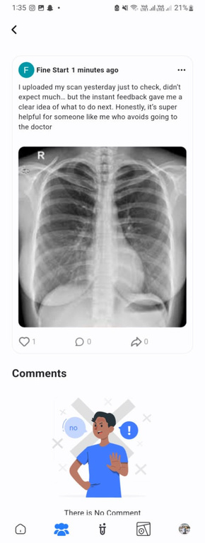
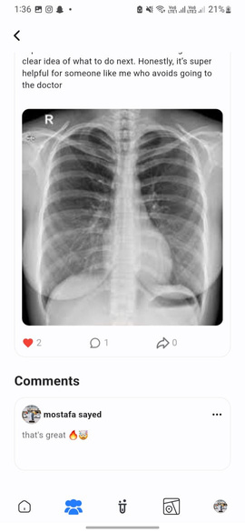
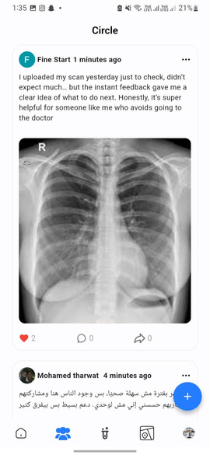
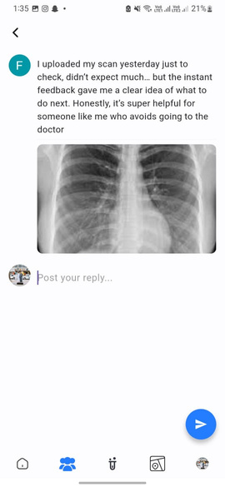
Share your excitement with a main post
about uploading your scan!
Join in with a lively comment
to boost the community spirit!
Share a bold comment to connect
and spark more insights!
Drop a comment to praise
the clear and helpful feedback!
Post a spirited comment
to engage and uplift others!
Fig-16.2: Community Feature
42

Slide 44
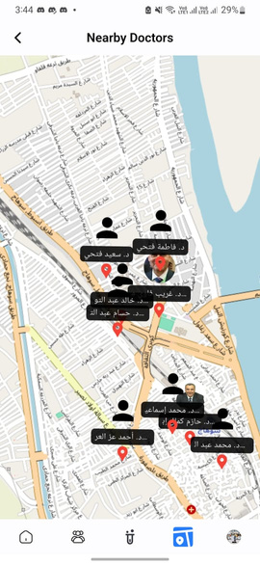



Discover Nearby Doctors with Ease
Showcase the interactive map feature,
highlighting nearby doctors with clear markers
for easy location tracking.
Demonstrate the one-tap "Call Doctor" button,
enabling instant communication
with healthcare providers.
Present the detailed doctor profile,
including ratings and specialties,
to guide users in making informed choices.
Explain the integrated dialer feature,
displaying the doctor’s contact number
for a smooth calling experience.
Fig-17: Map & Nearby Doctors Feature
43

Slide 45





Personalized User Experience
Manage your account details and
personalize your settings effortlessly.
Update your password securely
with a straightforward process.
Switch to Arabic for a seamless
and localized experience.
Update your personal information
securely to enhance your profile.
Toggle Dark Mode for a comfortable
and eye-friendly interface.
Fig-18.1: Profile & Settings Feature
44

Slide 46



Privacy Center with
data usage and control info.
Explore FAQs to clarify how Tamenny
enhances your health journey.
Profile with sign-out confirmation.
Fig-18.2: Profile & Settings Feature
45

Slide 47

Revolutionizing Healthcare with AI-Powered Diagnosis
Final Thought
Tamenny is not a replacement for doctors, but it helps bridge the gap between concerns and professional care.
It’s like having a supportive, knowledgeable assistant available 24/7.
Key Objective:
Save time and provide users with actionable insights before consulting a doctor.
46

Slide 48


Select Your Diagnosis with Ease
Select Your Diagnosis
Browse and choose from a list of diseases (e.g., lung issues).
Interactive and easy-to-navigate options.
Simple explanation of the selected disease with common symptoms.
Educational insights to help users understand their condition.
Highlights how AI analyzes scans for the chosen disease.
Displays previously analyzed images as a reference.
Fig-19: Ai-Model Diagnosis Feature
47

Slide 49






Seamless Scan Upload and Real-Time Progress
Navigate to the upload section
to start the diagnosis process.
Pick the specific scan
you want to analyze.
Real-time progress of
AI analyzing the scan.
Navigate to the upload section
to start the diagnosis process.
Review the uploaded scan
before proceeding.
View detailed analysis and
insights generated by the AI.
Fig-20: Ai-Model Diagnosis Feature
48

Slide 50



Accurate Results with Empowering Insights
Clear explanation of the detected condition
with key health metrics,.
AI-generated answers and recommended
next steps or tips.
Share results on the community feed or leave feedback.
Engage with others for advice, support, and shared experiences.
Assistance options for further
guidance or additional resources.
Fig-21: Results with Empowering Insights
49

Slide 51
Tamenny
Result

Slide 52

Note:
This video illustrates Tamenny's process: selecting a diagnosis, uploading scans, AI analysis, receiving results, and sharing insights with the community — all in an intuitive and seamless process..
52

Slide 53
Tamenny
Technologies &Tools

Slide 54

Technologies
Tools
Libraries
DL Models
Flutter
Dart
Python
CUDA
Provider
BLoC
Flutter Navigator
Hive
Dio
Lottie
Transformers
TensorFlow
Keras
OpenCV
PIL
Albumentations
NumPy
Matplotlib
Seaborn
Scikit-learn
EarlyStopping
ModelCheckpoint
CNN (Lung & Brain Cancer)
U-Net (Heart Segmentation)
ResNet-50 (Knee OA Classification)
FLAN-T5 (Symptom Chatbot)
XLM-ROBERTA BASE (Recommendation Sys)
NNmultiregressor (Recommendation Sys)
VS Code
Android Studio
Git & GitHub
Postman
Colab
Ngrok
pub.dev
Flutter DevTools
Jupyter Notebook
Railway
54

Slide 55
Tamenny
Time plan

Slide 56

Our Time Schedule:
First Term
56

Slide 57

Our Time Schedule:
Second Term
57

Slide 58
Tamenny
Conclusion

Slide 59
AI-Driven Diagnosis: Fast, accurate preliminary health assessments.
Community Support: Share experiences, gain advice, and connect with others.
User-Friendly Design: Simple, secure, and accessible for everyone
Personalized Recommendations: Provides tailored advice and resources based on individual health profiles.
Smarter Healthcare: Bridging the gap between early detection and professional care.
59

Slide 60
Tamenny
Future work

Slide 61
App Publishing: Launch Tamenny on Google Play Store to expand global accessibility and reach a wider user base.
New Disease Models: Continuously add new AI models for disease detection, including rare diseases and complex cases.
UI/UX Improvements: Refine the app interface based on user feedback to ensure smoother and more intuitive interaction.
Data Protection: Implement advanced security measures, fully aligned with HIPAA and GDPR global privacy standards.
61

Slide 62
Tamenny
Refrences

Slide 63
[1] Nurul Najiha Jafery,Siti Noraini Sulaiman,Muhammad Khusairi Osman,Noor Khairiah A. Karim,Zainal Hisham Che Soh, 2024 , “Enhancing Lung Cancer Classification: Leveraging Existing Convolutional Neural Networks within a 1D Framework”, “Institute of Electrical and Electronics Engineers(IEEE)”.
[2] Lakshmanaprabu S.K., Mohanty S.N., Shankar K., Arunkumar N., Ramirez G. Optimal deep learning model for classification of lung cancer on CT images. Future Gener. Comput. Syst. 2019;92:374–382. [Google Scholar]
[3] Arabahmadi M., Farahbakhsh R., Rezazadeh J. Deep Learning for Smart healthcare—A Survey on Brain Tumor Detection from Medical Imaging. Sensors. 2022;
[4] Shah D., Patel S., Bharti S.K. Heart Disease Prediction using Machine Learning Techniques. SN Comput. Sci. 2020
[5] Otoom A.F., Abdallah E.E., Kilani Y., Kefaye A., Ashour M. Effective diagnosis and monitoring of heart disease. Int. J. Softw. Eng. Its April 2015
[6] Karim MdR, Jiao J, Döhmen T, Cochez M, Beyan O, Rebholz-Schuhmann D, Decker S. DeepKneeExplainer: Explainable Knee Osteoarthritis Diagnosis From Radiographs and Magnetic Resonance Imaging. IEEE Access 2021
[7] Bora A, Cuayáhuitl H. Systematic Analysis of Retrieval-Augmented Generation-Based LLMs for Medical Chatbot Applications. Machine Learning and Knowledge Extraction. 2024; Volume 6, Issue 4: Pages 923–944.
[8]K. K. Jayanth, G. B. Mohan, and R. P. Kumar, Indian Language Analysis with XLM-RoBERTa: Enhancing Parts of Speech Tagging for Effective Natural Language Preprocessing, Nov. 22, 2023.
[9] Cruz-Conesa, A., et al. (2022). Multivariate regression via artificial neural networks for compost quality prediction. Computers and Electronics in Agriculture, 194, 106726. Zhang, Y., et al. (2019). Hierarchical deep learning for multivariate time series. Proceedings of the AAAI Conference, 33, 7495-7502.
[10] Google Developers. Flutter SDK: Version 3.5.4. Available online: https://flutter.dev/ .
[11] Dart Team. Dart Programming Language. Available online: https://dart.dev/ .
63

Slide 64
[12] Google Firebase. Firebase for Flutter. Available online: https://firebase.flutter.dev/ .
[13] Supabase Inc. Supabase for Flutter. Available online: https://supabase.com/docs/guides/with-flutter .
[14] A. Mahimkar, “IQ-OTH/NCCD - Lung Cancer Dataset,” Kaggle, 2022. [Online]. Available: https://www.kaggle.com/datasets/adityamahimkar/iqothnccd-lung-cancer-dataset
[15] obulisainaren, “Multi Cancer Dataset”, Kaggle,2022 [Online]. Available: https://www.kaggle.com/datasets/obulisainaren/multi-cancer
[16] Msoud Nickparvar. (2021). Brain Tumor MRI Dataset [Data set]. Kaggle. https://doi.org/10.34740/KAGGLE/DSV/2645886
[17] Ahmed Hamada , “Br35H :: Brain Tumor Detection 2020“ , Kaggle,2020[Online]. Available:https://www.kaggle.com/datasets/ahmedhamada0/brain-tumor-detection/data
[18] Pradeep2665 , “Brain MRI”,Kaggle,2022,[Online]. Available : https://www.kaggle.com/datasets/pradeep2665/brain-mri
[19] Nikhil Tomar, "CT Heart Dataset, Kaggle 2021" [Online], Available : https://www.kaggle.com/datasets/nikhilroxtomar/ct-heart-segmentation
[20] M. Gobara, “Osteoporosis Database,” Kaggle, 2022. [Online]. Available: https://www.kaggle.com/datasets/mohamedgobara/osteoporosis-database
[21] Niyar R Barman and 2 collaborators- Symptom2Disease - Kaggle -2023. [online] https://www.kaggle.com/datasets/niyarrbarman/symptom2disease/data
[22] Nirali vaghan -Chatbot dataset - kaggle - 2023 - [Online]. available: https://www.kaggle.com/datasets/niraliivaghani/chatbot-dataset
64

Slide 65
Tamenny
Thank You

